Slide 1
Mutual Coupling Compensation in Compact Antenna Array for Direction of Arrival Estimation
ECE1229 Course Project
Presentation by : Qiu Hua Tian and Xiuquan Zhang

Slide 2
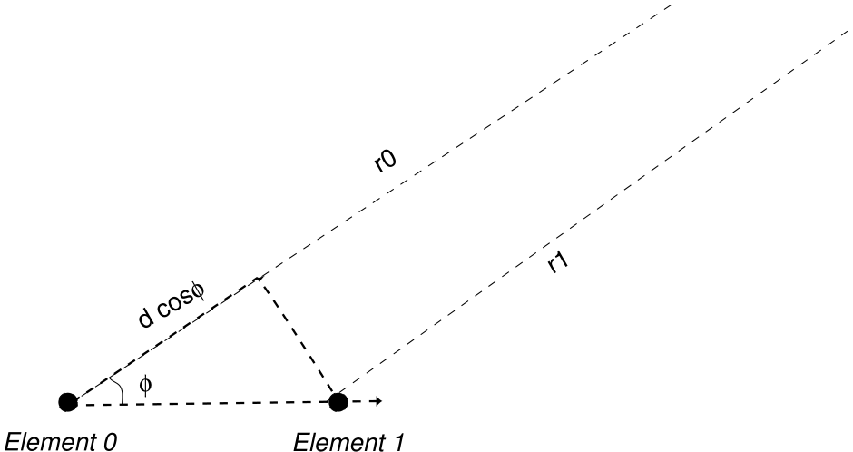
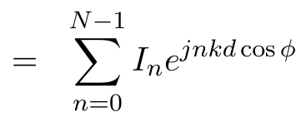

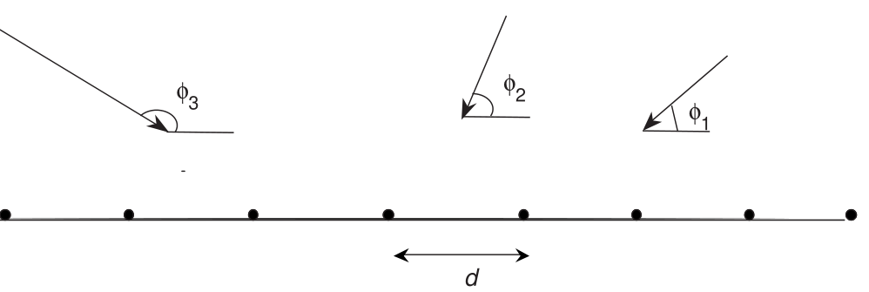
Motivation
We know:
Goal: Estimate φ’s

Slide 3
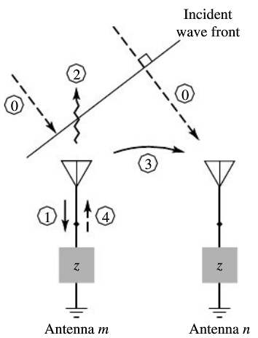
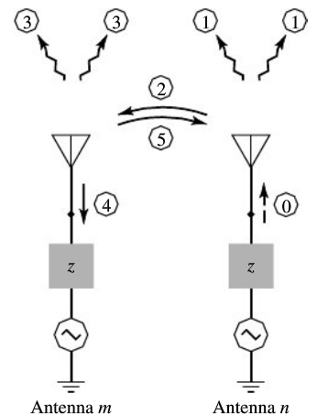
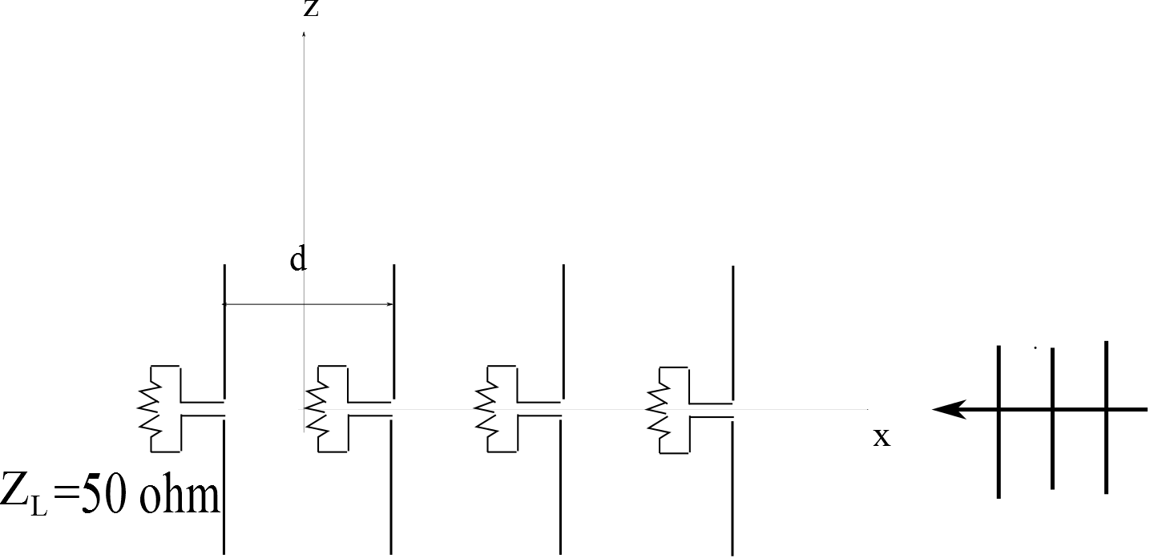
Motivation
[1]
Mutual coupling in
Transmitting mode
Mutual coupling in
Receiving mode
DOA estimation

Slide 4

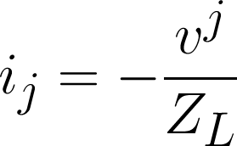

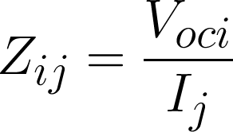
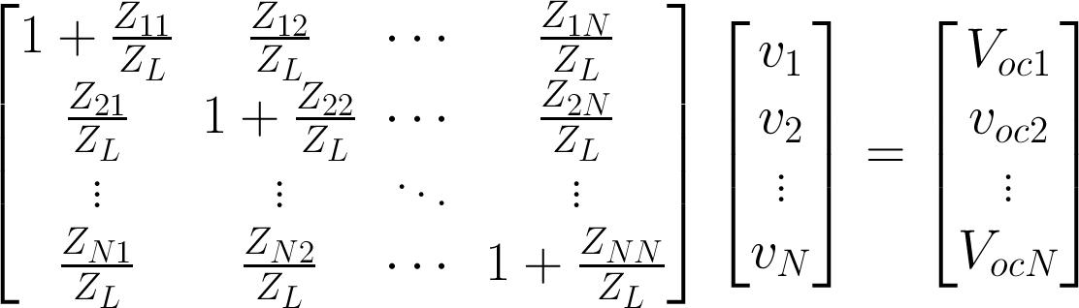
Approach 1: Open Circuit Voltage Method
[2][3]
Shortcoming of the method:
The model does not match receiving array exactly, especially when
antenna separation is small, antenna is electrically large or external excitation distribution on an antenna element is different from that caused by embedded current source

Slide 5
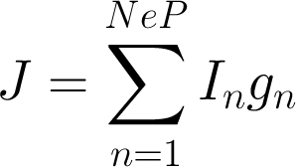


Approach 2: Full-Wave (Moment) Method
[4][5]
Assumption: only a single basis function contributes to the current at the port of each antenna element
Ne: # of antenna elements
P: # of basis functions per element
,
Ne × NeP
Underdetermined system, performance depends on approximation made
Accurate analysis tool of mutual coupling effect if E^{inc} known

Slide 6
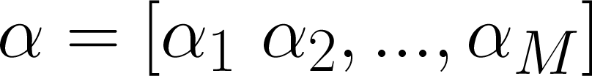
DoA Estimation via MUSIC
[6][7]
MUSIC: Multiple Signal Classification
M signals impinging upon N antennas
Voltage vector seen at terminals:
where
T
T

Slide 7
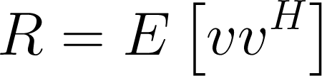
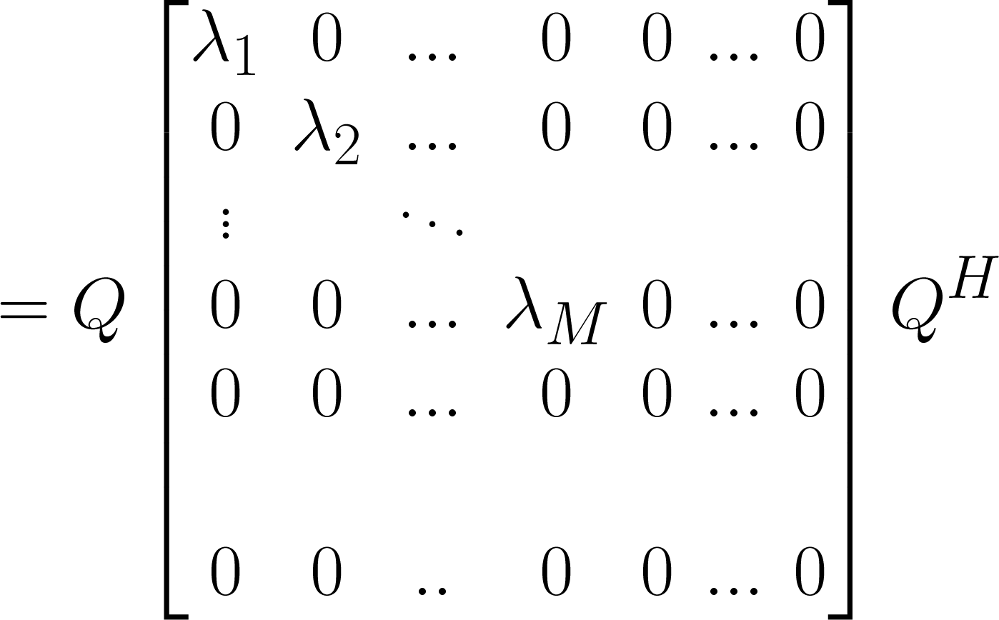

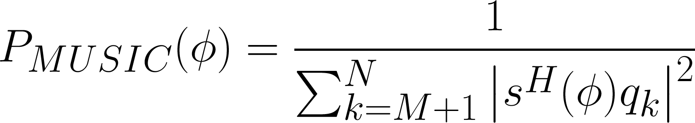
DoA Estimation via MUSIC
Assuming uncorrelated signals
,
Pseudo-spectrum:

Slide 8


Approach 3: Calibration Method
[7]
Given cost function
With approximated decoupling matrix, approximate Φ_{m}
Minimize J_{c} over decoupling matrix coefficients
Update Φ_{m} and other relevant parameters
Iterate till convergence

Slide 9

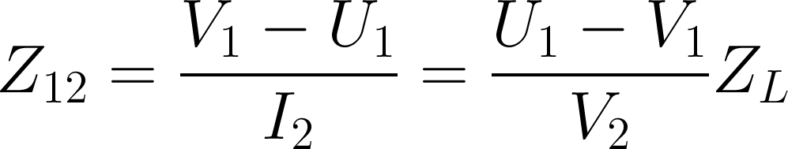
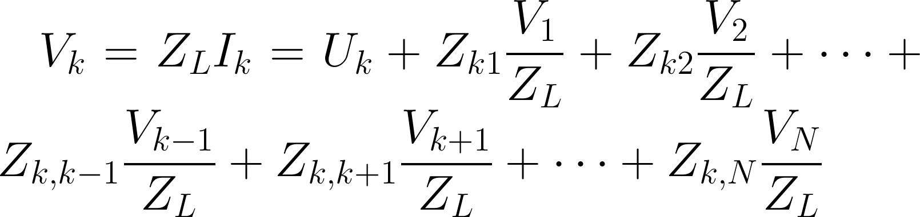
Approach 4: Receiving Mutual Impedance Method
[8][9]
E^{inc}
Voltage measured at 1’s terminal
Voltage measured at 1’s terminal with 2
Removed (uncoupled case)
#1
#2
New definition of mutual impedance:
Induced voltage across
kth element:

Slide 10
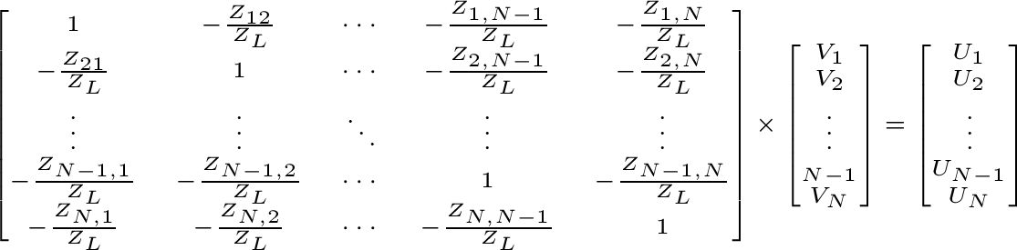
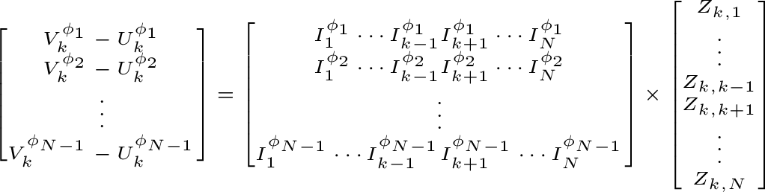
Receiving Mutual Impedance Method
Uncoupled
voltages
N-1 unknowns in each row, need N-1 angles to recover each row

Slide 11
Simulation Setup
Linearly polarized E^{inc}
System param:
L=300mm
f=1GHz
Compensating matrix
computed at:
Φ =30⁰
Φ =50⁰
Φ =80⁰
θ =0⁰
d=0.5λ
d=0.3λ
d=0.15λ

Slide 12
Simulation Results
Case d=0.5λ

Slide 13
Simulation Results
Case d=0.5λ, 2 incoming signals

Slide 14
Discussion of Results
Increase number of elements to improve detection
In all signal processing algorithms, the receiver is assumed to be an ideal, equispaced, linear array of isotropic point sensors
DOA estimation assumes linear phase front

Slide 15
Simulation Results
Case d=0.3λ

Slide 16
Simulation Results
Case d=0.15λ

Slide 17
References
C.A.Balanis, Antenna Theory and Design, Chapter 8, Wiley, New York, 1997, 2nd ed.
H.T.Hui, “Decoupling Methods for the Mutual Coupling Effect in Antenna Arrays: A Review”, Recent Patents on Engineering, 1, 2007, pp. 187-193.
I. J. Gupta and A. A. Ksienski, “Effect of mutual coupling on the performance of adaptive arrays,” IEEE Trans. Antennas Propag. 1983; 31(9): 785-791.
C.K.E. Lau, R.S.Adve, T.K.Sarkar “Minimum Norm Mutual Coupling Compensation with Application in Direction of Arrival Estimation”, IEEE Trans. Antennas Propag., vol.52,no.8, August 2004, 2034-2039
R.S.Adve, T.K.Sarkar , “Compensation for the Effects of Mutual Coupling on Direct Data Domain Adaptive Algorithm”, ”, IEEE Trans. Antennas Propag., vol.48,no.1, January 2000, 86-94
K.M.Pasala, E.M.Friel, “Mutual Coupling Effects and Their Reduction in Wideband Direction of Arrival Estimation”, IEEE Transactions on Aerospace and Electronic Systems, ISSN 0018-9251, 1994, Volume 30, Issue 4, pp. 1116 – 1122
B.Friedlander, A.J.Weiss, “Direction Finding in the Presence of Mutual Coupling”, IEEE Transactions on Antennas and Propagation, ISSN 0018-926X, 1991, Vol 39, Issue 3, pp. 273 - 284
R.S.Adve, “Direction of Arrival Estimation”, course notes, http://www.comm.utoronto.ca/~rsadve/Notes/DOA.pdf, accessed 27 December 2013
H.T.Hui, “A New Definition of Mutual Impedance for Application in Dipole Receiving Antenna Arrays”, IEEE Antennas and Wireless Propagation Letters, vol.3, 2004, 364-367
H.S.Lui, H.T.Hui,”Improved Mutual Coupling Compensation in Compact Antenna Arrays”, IET Microwaves, Antennas&Propagation, October 2010, 4 (10), pp. 1506-1516

